Slide 1
Pavia Ward
Monalisa Kupakuwana
Emma Breen
Manchester Industrial Relations Society Student Debate

Slide 2
Why is employee engagement and participation so important??
Notes:
Are you fostering an environment of passionate employees with a profound connection to the company. Or is your company causing workers to feel demotivated making them sleepwalk through the day??

Slide 3
Hear my Voice
Notes:
Changes in the nature of work carried out in the UK, from manufacturing to more knowledge based work, has seen a shift in the nature of employee participation
Employee empowerment became prominent in the 1990’s with high commitment and performance taking over in the early 2000s.
Since 2010 the new terms used are employee engagement and employee voice

Slide 4
But do current forms of employee involvement transfer any real decision-making powers away from managers?
Notes:
Employee participation has been an important feature for debates in work and employment since 1987 but do current forms of employee involvement really transfer and real decision-making powers away from managers?
We believe that yes it does – but how??

Slide 5
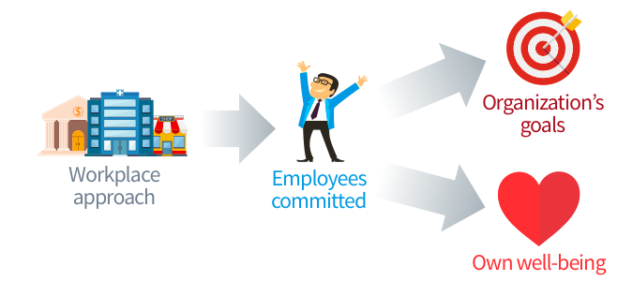
Notes:
Employee voice/involvement in a non-union world
With the decline of TU in recent years organisations are increasing employee involvement as a way of replacing TU
Research evidence tells us that by adopting an engagement approach can have a positvive impact for both employees and employers
B

Slide 6
Notes:
There are different ways in which workers can influence decisions over managers and this can be achieved in a number of ways
Reasons why!!!
Involving employees in decision making is key to employee engagement and organisational success.

Slide 7
When employees rule…...........
Notes:
Lets take John Lewis as an example – where employees rule!!
Empowering staff!!!
69,000 employees across Waitrose and John Lewis - known as Partners because they own the business!! - the challenge for the management is to ensure that they all have opportunities to have their say across all levels of the business.
Ensuring employees have a clear say in the running of the business is also seen in individual John Lewis and Waitrose shops through Branch Forums.
Partners are elected by their colleagues onto each Forum and work alongside management to influence the running of the shop and to make decisions such as which local charities to support.
JLP has a long-established Partnership Council which brings together 80 elected partners four times a year to discuss issues across the business. The Chairman and other Board Directors present to the Council on a regular basis and the Council has the ultimate power to remove the Chairman.

Slide 8
Notes:
Monalisa

Slide 9
Notes:
Solid foundations of any succesful company is its people
Employees represent a source of knowledge and ideas but often this remains untapped. By tapping into this knowledge it empowers employees, saves company time and money and increases productivity and outsourcing.
Sam Walton - Walmart – The way management treat their employees is exactly how employees will treat their customers

Slide 10
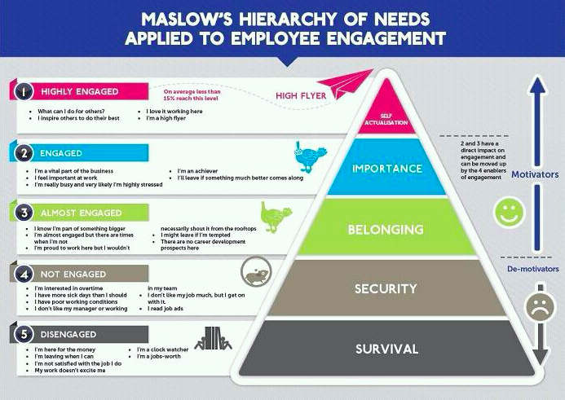
Notes:
Motivation

Slide 11
Notes:
What happens if Managers don’t listen!!
Failing to respond to employees is a sure way to kill employee involvement and potentially the business. If management do not acknowledge employee ideas and efforts, staff will conclude that the management has no interest in the welfare of employees, which will demotivate employees, resulting in lack of productivity and ultimately decreasing the profits of the organisation. BOOM business gone

