Slide 1
HRM operates in the interest of management and not employees
By Areekah Ali, Andrea Stein and Precious Murefu

Slide 2
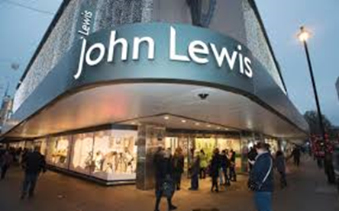
Key Claims of HRM
No more ‘them and us’
Mutually beneficial for both management and employees
Recognises the importance of employee engagement and commitment

Slide 3
1
It is particularly managerial in orientation through reinforcing managerial values and goals in the workplace.

Slide 4
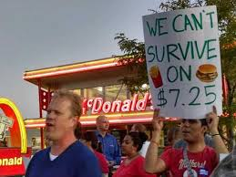
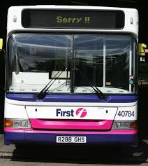
2
There is no recognition of the existence of different interest between workers and management which are genuine and legitimate.

Slide 5
3
The assumption of consensus and harmony in the workplace does not concur with reality.

Slide 6
4
Employee voice is not taken into account and is part of a broader HR agenda.

Slide 7
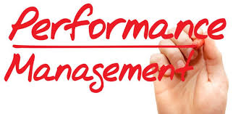
5
HRM is all about increasing employee performance.

Slide 8
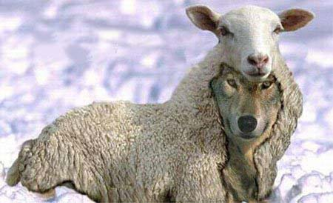
Conclusion
HRM is a wolf in sheep’s clothing

Slide 9
References
Dundon, T., Wilkinson, A., Marchington, M. and Ackers, P. (2005), The Management of Voice in Non-Union Organisations: Managers Perspectives, Employee Relations, Vol 27 (3), pp 307-319.
Williams, S. (2017). Introducing Employment Relations: A Critical Approach (4th edition). Glasgow: Oxford University Press.
Helen Cahill (2016) M&S accused of threatening to sack staff who reject new contracts http://www.cityam.com/245337/pay-row-ms-accused-threatening-sack-staff-reject-new
Health and Safety Executive (2017). Stress at work. Retrieved from http://www.hse.gov.uk/stress/index.htm
Fight For 15 $ (2017). Retrieved from https://fightfor15.org/food-stamps/
Fortune 500 (2017). Retrieved from http://fortune.com/fortune500/mcdonalds/
Ruddick, G. (2016, 21 September) Thousands of M&S staff could lose jobs if they reject pay deal, says MP. The Guardian. Retrieved from https://www.theguardian.com/business/2016/sep/21/marks-and-spencer-staff-jobs-pensions-pay-working-conditions
First Group (2017). Bus drivers strike October 2017. Retrieved from https://www.firstgroup.com/greater-manchester/news-and-service-updates/planned-changes/bus-drivers-strike-october-2017
XPO Logistics. (2017) Our Values. Retrieved 16/11/2017, from https://www.xpo.com/about-us/our-values

Slide 10
Thank you for listening

